Slide 1
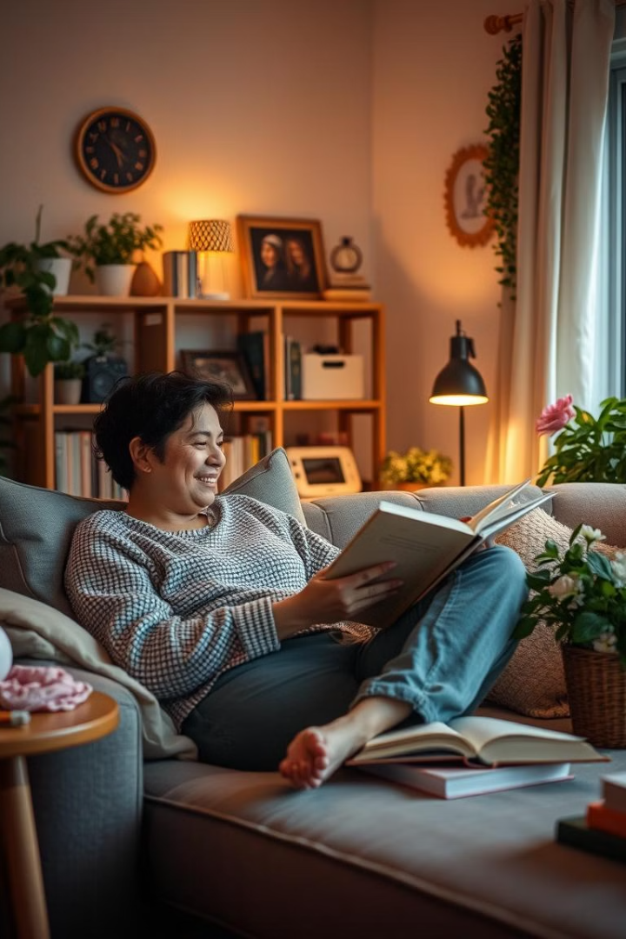
My Favourite Hobbies
I have a diverse range of hobbies that bring me joy and fulfillment. From immersing myself in the pages of a good book to capturing stunning photographs on my travels, each hobby allows me to explore my passions and unwind.
by Dolly Khatun

Slide 2

Introduce Myself
Hello! My name is Dolly Khatun, and I'm excited to share my favorite hobbies with you. I'm a passionate and curious individual who loves to explore new interests and find ways to enrich my life. Each of my hobbies brings me joy and fulfillment in unique ways, and I'm always eager to learn and grow.

Slide 3

Reading
Escapism
Knowledge Expansion
Reading transports me to new worlds, allowing me to step away from the stresses of daily life.
I love learning about different subjects and gaining new perspectives through the books I read.
Relaxation
Curling up with a good book is one of my favorite ways to unwind and recharge.

Slide 4
Gardening
Connection to Nature
Stress Relief
Sense of Accomplishment
Gardening allows me to connect with the natural world and appreciate the beauty of the outdoors.
The physical act of gardening and tending to my plants is a calming and therapeutic experience.
Watching my garden grow and thrive fills me with a deep sense of pride and satisfaction.

Slide 5
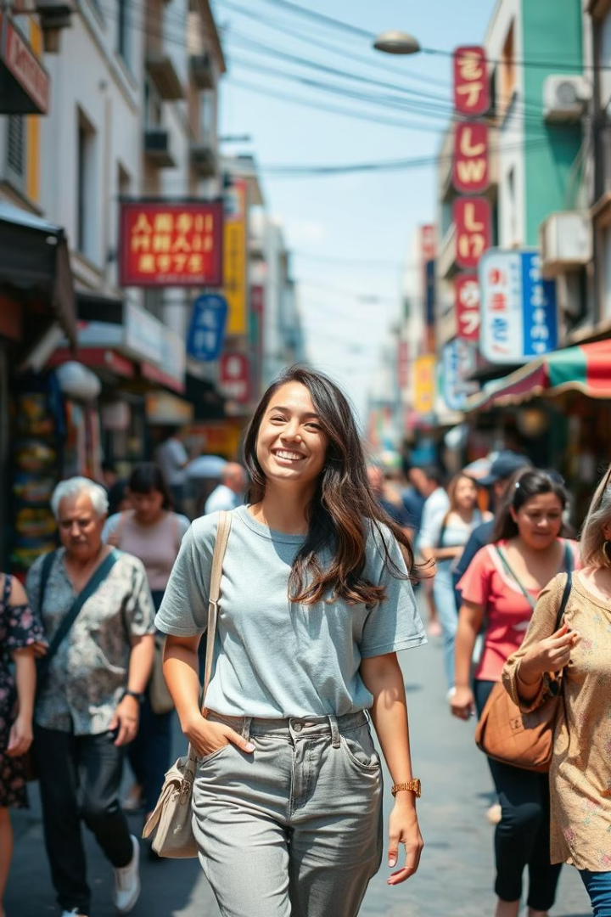
Traveling
1
Exploration
Traveling allows me to discover new places, cultures, and experiences that broaden my horizons.
2
Adventure
I love the thrill of venturing into the unknown and embracing the unexpected on my travels.
3
Personal Growth
Stepping out of my comfort zone and immersing myself in different environments helps me grow as an individual.

Slide 6
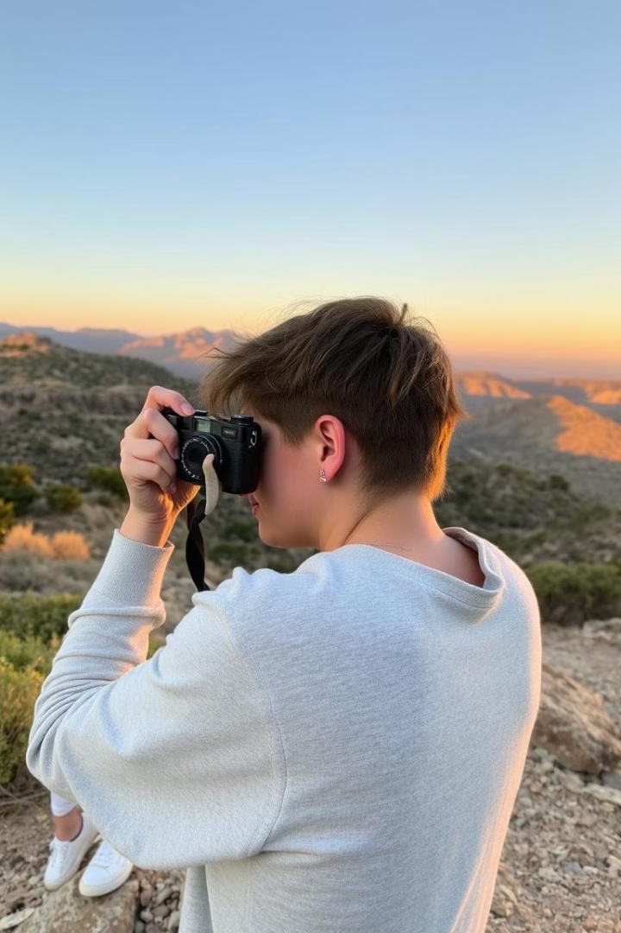



Photography
Capturing Moments
Photography allows me to freeze time and preserve memories that I can cherish forever.
Artistic Expression
I find joy in using my camera to artfully depict the world around me.
Appreciating Beauty
Photography helps me to slow down and truly appreciate the beauty of my surroundings.

Slide 7




Journaling
Reflection
Journaling allows me to reflect on my thoughts, emotions, and experiences, fostering self-awareness.
Self-Expression
Writing in my journal is a therapeutic outlet for me to express myself freely.
Personal Growth
Keeping a journal helps me track my progress and identify areas for personal development.

Slide 8
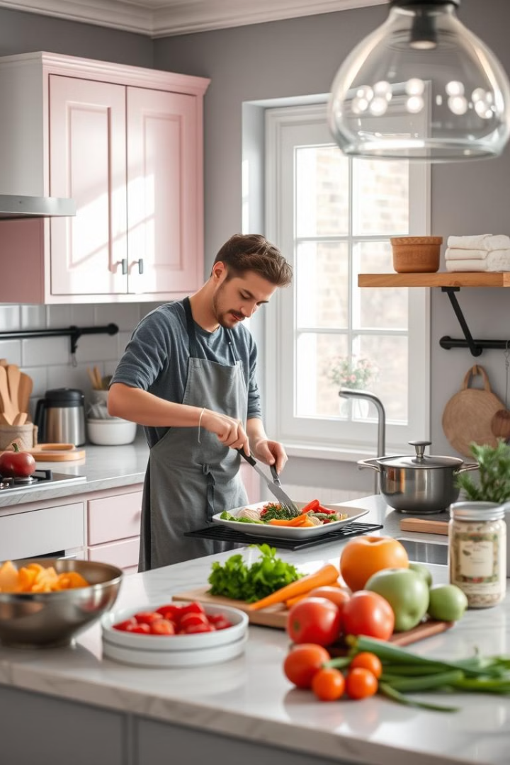
Cooking
Creativity
Cooking allows me to unleash my creativity by experimenting with new recipes and flavors.
Mindfulness
The act of chopping, stirring, and assembling a meal helps me stay present and focused.
Nourishment
I find joy in preparing healthy, delicious meals that nourish both my body and soul.

